Slide 1

Versions
Current Version: 1.9.0 (Nov 29, 2016)
Version Used: 1.6.0

Slide 2
Agenda
Topics
Introduction
Data Sources and File Formats
Query Execution Flow
Storage Plugin
Supported SQL Commands
Installation Procedure
Connecting to Drill via JAVA
Test Yourself
Assignment
Topics
Limitations
Sample Query
Drill in Distributed Mode

Slide 3































Big Data Ecosystem
Streaming Engines
Data Store
Data Processing
Peripherals
Data Services
Distributions
Cloud Exposure

Slide 4
Introduction
What is Apache Drill?
Drill is an Apache open-source Schema-free SQL query engine for Big Data exploration.
History Of Drill
Why Apache Drill ?
Inspired by Google's Dremel System (A system for interactively querying large dataset), he founded Drill
Tomer Shiran , a MapR member is the founder of Apache Drill.
Drill is the only distributed SQL engine that doesn't require schemas.
Real SQL -- not "SQL-like" : Drill supports the standard SQL:2003 syntax.
Access multiple data sources
No need to transform the data prior to or during query execution.

Slide 5
Data Sources and File Formats
HBase
Hive
File
systems
RDBMS
MongoDB
Data
Sources
File formats include :
CSV (Comma-Separated-Values)
TSV (Tab-Separated-Values)
PSV (Pipe-Separated-Values)
JSON
Hive/Hbase/RDBMS tables
Avro
Parquet

Slide 6
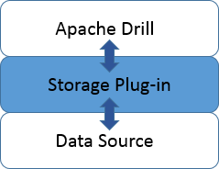
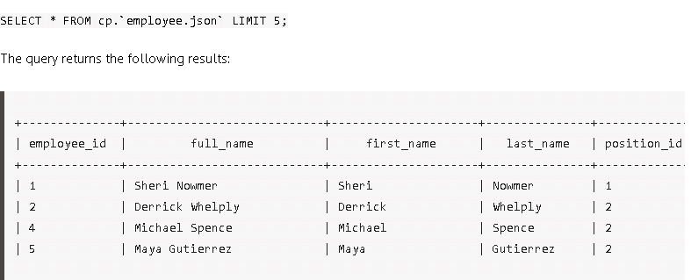
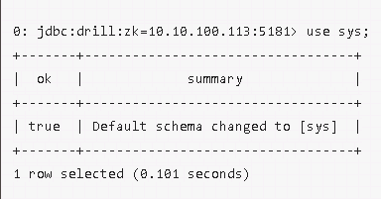

Storage Plugin
A storage plugin is a software module for connecting Drill to data sources.
A storage plugin typically optimizes execution of Drill queries, provides the
location of the data, and configures the workspace and file formats for reading data.
When you execute a query, Drill gets the storage plugin configuration name in one of several ways:
The FROM clause of the query can identify the plugin to use.
The USE
You can specify the storage plugin when starting Drill.
From
Use
While Starting Drill

Slide 7
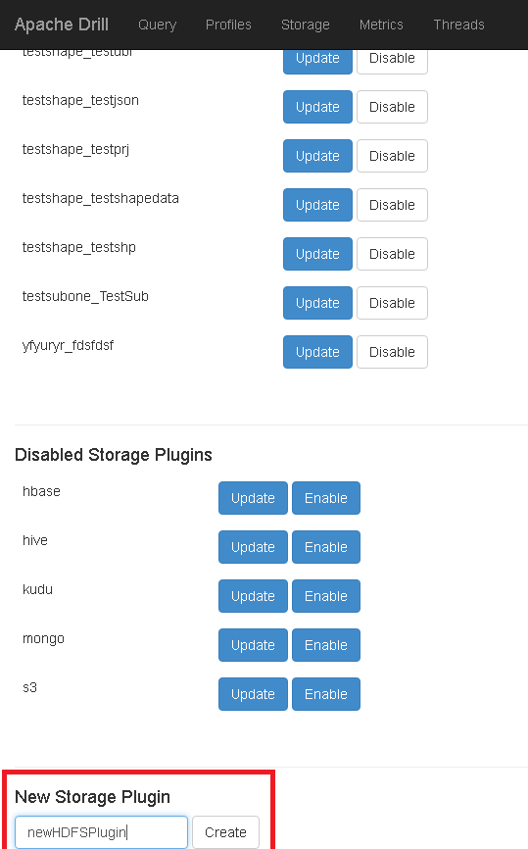
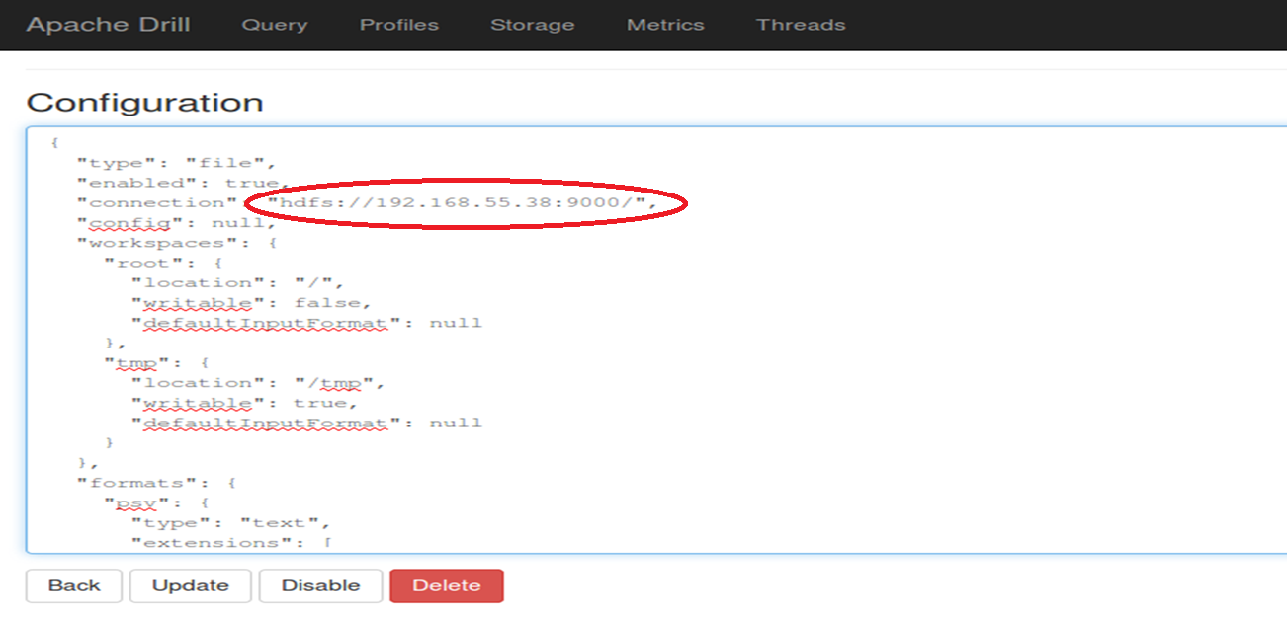
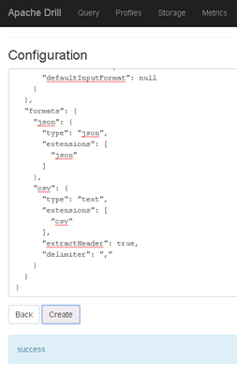
Storage Plugin Example – HDFS
Step 1 Step 2 Step 3

Slide 8
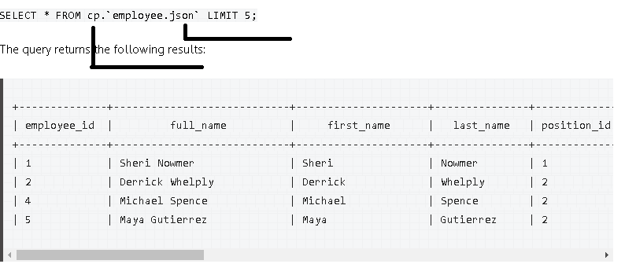
Sample Query
File Name
Storage Plugin

Slide 9

Query Execution Flow
Client : Drill web console, Drill shell, JDBC/ODBC Client.
Drillbit: A Drillbit is the process running on the active Drill node that coordinates, plans, and executes queries, as well as distributes query work across the cluster.
Foreman: The Drillbit that receives the query from a client or application becomes the Foreman for the query and drives the entire query.
Logical plan: The logical plan describes the work required to generate the query results and defines which data sources and operations to apply.
Physical plan: Describes how to execute the query.

Slide 10
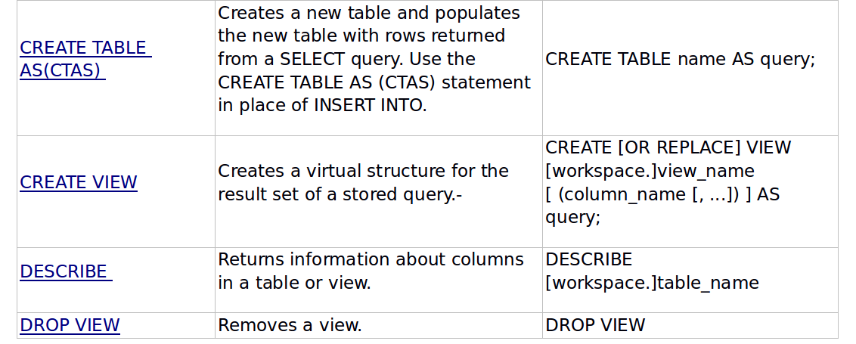
Supported SQL Commands

Slide 11
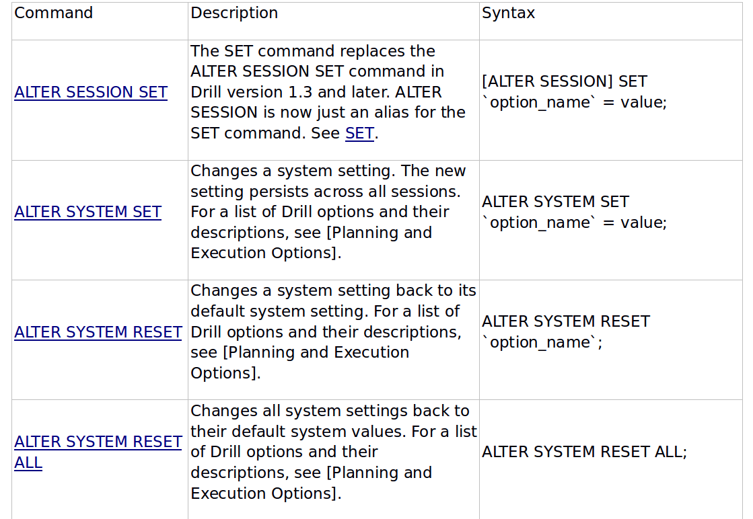
Supported SQL Commands

Slide 12
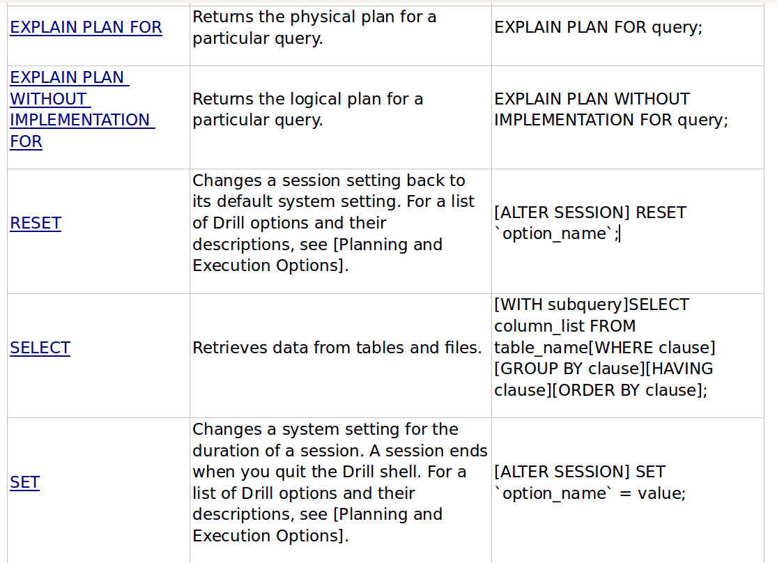
Supported SQL Commands

Slide 13
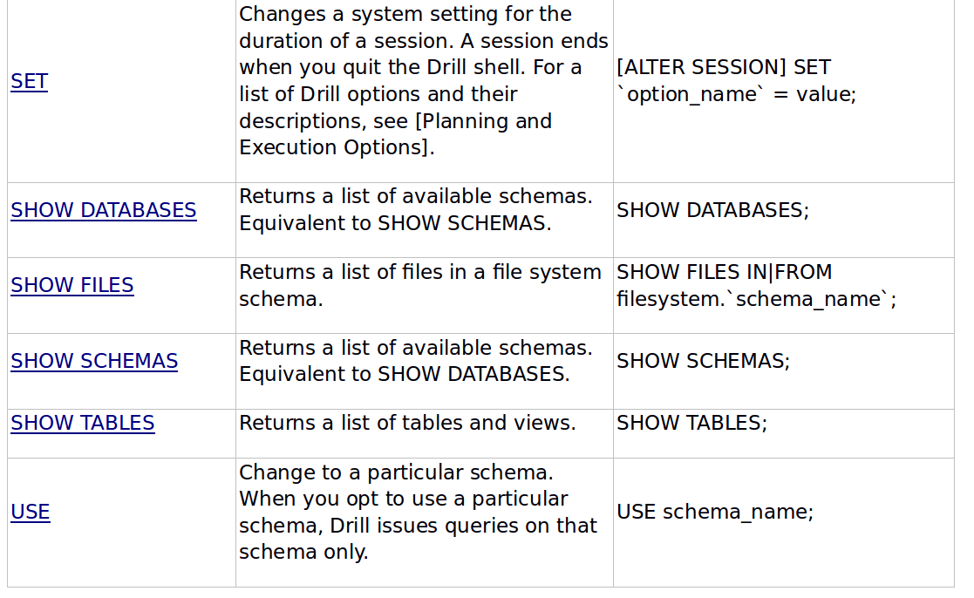
Supported SQL Commands

Slide 14
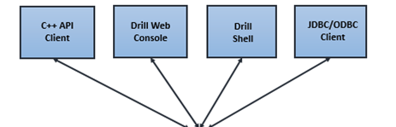
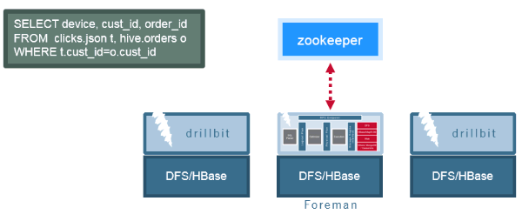
Drill in Distributed Mode
Drill works with the help of zookeeper in distributed mode.
A client uses zookeeper to find a drillbit to submit a query (jdbc:drill:zk=<zookeeper_quorum>/<drill_directory_in_zookeeper>/<cluster_ID>)
The Drillbit that accepts the initial query becomes the Foreman for the request.
Any Drillbit in the cluster can accept queries from clients.
There is no master-slave concept.
The foreman gets a list of available Drillbit nodes in the cluster from ZooKeeper, and determines the appropriate nodes to execute various query plan fragments to maximize data locality.
Drill has its own SQL execution engine. It does not rely on MapReduce , Spark , Tez , etc.

Slide 15

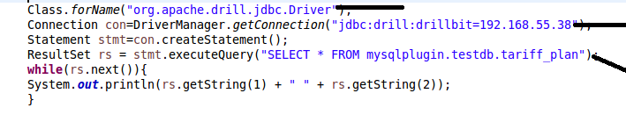
Connecting to Drill via Java
Dependency
Java Code
Main Class
Drill Bit
Query

Slide 16

Limitations
Limitation on the data type supported – It does not support xml, kml, shape files, etc..
Only limited no of aggregate functions supported.
Only limited no of spatial function support.

Slide 17


Installation procedure
For installation of Drill in Ubuntu, follow the below link:
https://drill.apache.org/docs/installing-drill-on-linux-and-mac-os-x/
Official Site :
https://drill.apache.org/

Slide 18


Test Yourself
Answer the following questions:
Will drill be able to query schema based data store ?
Is initial loading of data into drill required?
Which big data distribution supports drill?
Can drill be used to query cloud storage such as Amazon S3?
Yes, if schema is present it takes advantage of it. It is not an anti-schema.
Yes, it can be used for cloud storage.
What will happen if a foreman dies?
No, it does not require data to be loaded into drill.
The client will fail the query when the foreman dies.​
What SQL functionality does Drill support?
MapR is the only big data distribution that supports drill.
Drill supports standard SQL (SQL:2003 syntax)

Slide 19
Assignment
Connect to following data sources
File System (HDFS)
Hbase
MySQL
Load the “crime” data into the above data source and write queries for the following functionalities
SELECT ALL
SELECT BY COLUMN
SUM()
MIN()
MAX()
COUNT()
Querying complex data:
Query the above JSON for the following:
Use WHERE clause
Use Join
Use FLATTEN
Use KVGEN
Select all topping IDs

